Slide 1
Design of an Autopilot for Boeing 737-800 Aircraft
Kwasi D-P

Slide 2
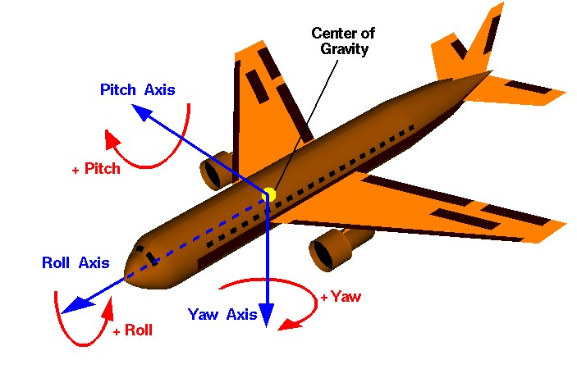
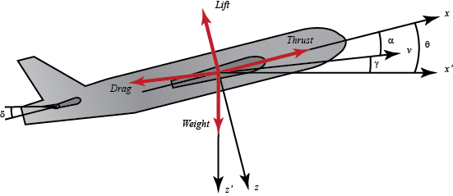
Problem Description
This project involves the design and simulation of an aircraft using Simulink and FlightGear (plane simulation software integrated in Simulink), with the aircraft variables coming from an analysis on the Boeing 737-800
Coordinate Axes:
Forces in the x-z plane for an aircraft
3D axis of an aircraft

Slide 3
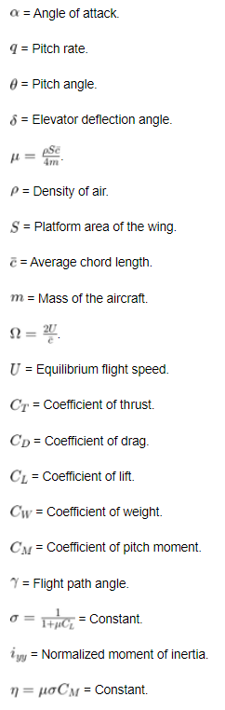
Environment and Plane Variables for Boeing 737-800
Coefficient of thrust: Ct = 0.297
Coefficient of lift: Cl = 0.445
Coefficient of drag: Cd = 0.021
Coefficient of weight: Cw = 0.04
Coefficient of pitch moment: 0.02
Flight path angle: 5 degrees
Pitch angle: theta = 1 degree
Gamma: 1.0
Equilibrium flight speed: U = 1000 km/h
Omega: 141.20 m/s
Moment of inertia about pitch: Iyy = 3,394,953 kg*m^2
Nu: 4.24e-5
Mu: 0.00212
Mass: 41,145kg
Chord Length: 7.88m
Platform area of wing: 34.32 m^2
Density of air: 1.293 kg/m^3

Slide 4
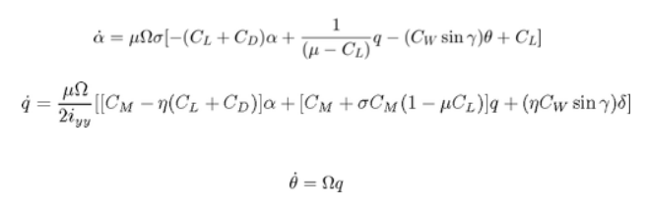
Equations of Motion
Some assumptions for our equations of motion:
Thrust, drag, weight, and lift balance each other out
Our aircraft moves steadily at a constant altitude and velocity
Change in pitch will not change speed
With these assumptions, our equations of motion are as follows:

Slide 5
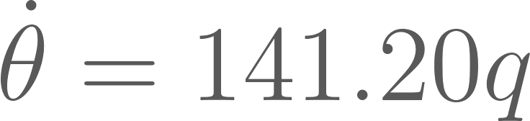
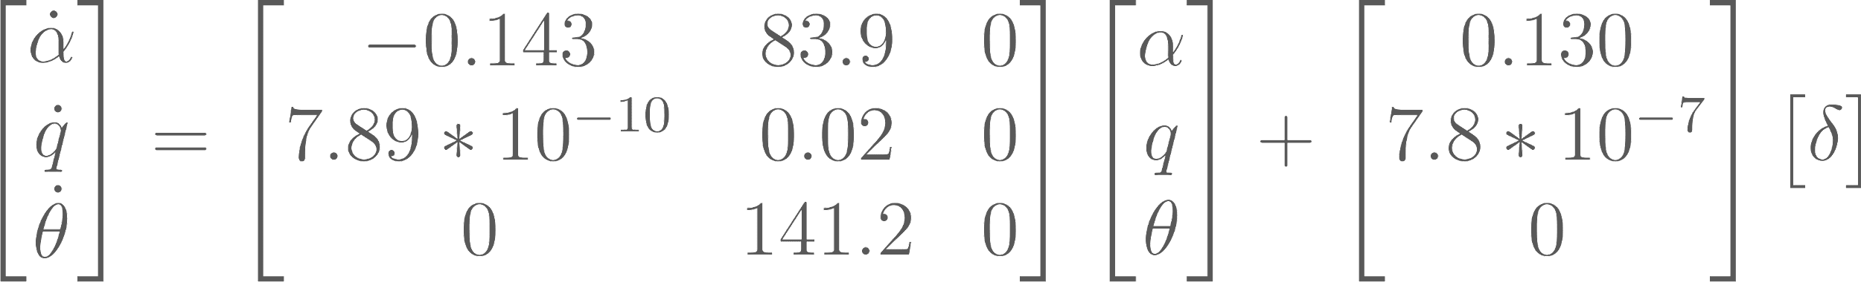
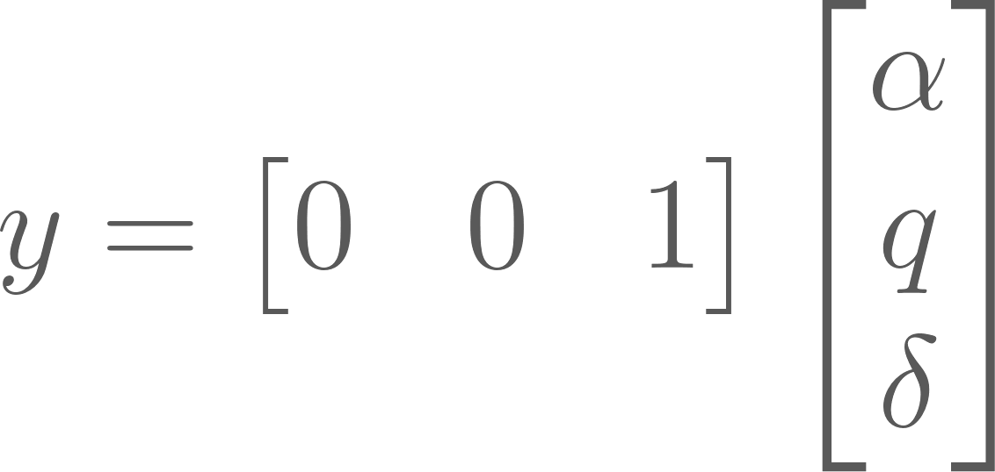
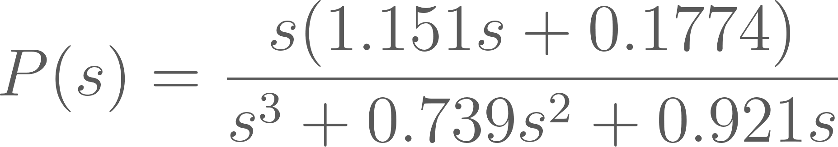
State-Space Representation and Transfer Function
Using our variables, our equations of motion are as follows:
In State-Space form:
Using Laplace Transforms, we can also get our Transfer Function:

Slide 6
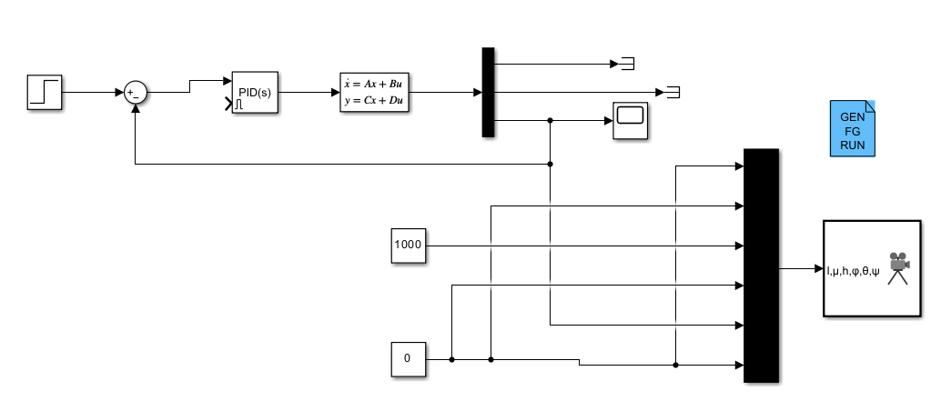
Simulink Model

Slide 7
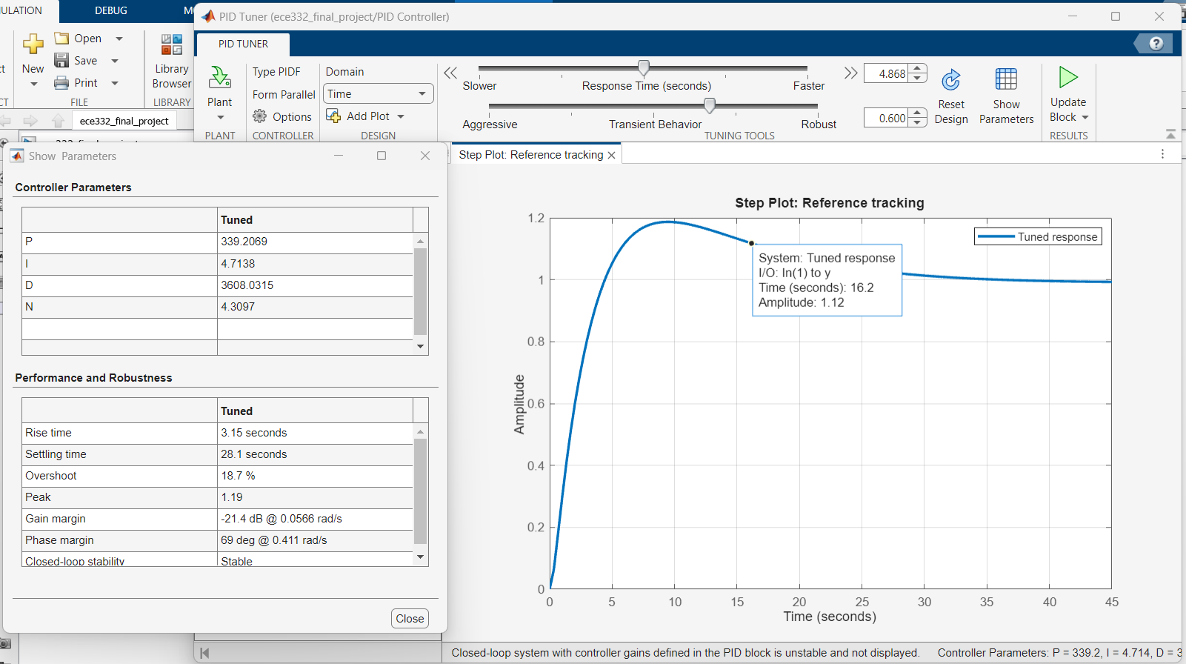
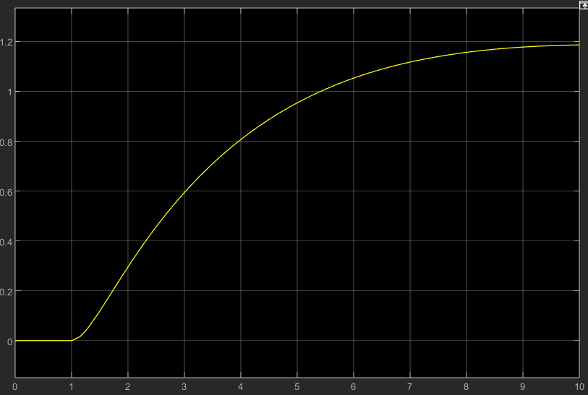
Simulink Model Specifics and Output
For my system, I used a PID block and tuned it using the PID Tuner Simulink Application
Simulink Output for Model
PID Tuner Application

Slide 8
Simulink Model Specifics and Output (cont’d)
Model involves closed-loop control with step input, with the controller being the PID controller and the plant being the state variables for the system
The system outputs: “Angle of Attack”, “Pitch Rate”, and “Pitch Angle”
The scope outputs Pitch Angle, whereas the other two are “terminated”
The block in the bottom right and the blue block are the FlightGear simulator integration blocks
The blue block generates the script that connects FlightGear to Simulink
The other block takes in 6 inputs: longitude, latitude, altitude, roll, pitch, and yaw
I set longitude, latitude, roll, and yaw to 0, altitude to 1000, and pitch as the Pitch Angle output from my system

Slide 9

FlightGear Simulation
This is a video of my model simulated in FlightGear, a flight simulator capable of being connected to Simulink
It is a bit hard to see, but you can see like in my scope output from the last slide, the plane’s altitude seems to converge around the 10 second mark

Slide 10
Problems Encountered
I am new to using the FlightGear simulator, so I feel my simulation was not as robust or clear as it could have been
I was having trouble finding the variables needed for the equations of motion. I originally wanted to do a version of the Boeing 777, but I had to switch to the Boeing 737 due to finding more of these variables easier
Even though I had an easier time finding variables with the 737, I still had trouble finding a few of the variables. For the ones that I could not find any information on, I just had to estimate based on the typical range for the value in question

Slide 11
Bibliography
https://ctms.engin.umich.edu/CTMS/index.php?example=AircraftPitch&section=SystemModeling
https://www1.grc.nasa.gov/beginners-guide-to-aeronautics/aircraft-rotations/
http://www.b737.org.uk/techspecsdetailed.htm
https://devsupport.flightsimulator.com/t/is-drag-coef-zero-lift-the-same-thing-as-cd0-how-do-i-match/5804
https://reference.wolfram.com/system-modeler/libraries/Aircraft/Aircraft.Physical.FixedWing.Boeing737800.html
https://aviation.stackexchange.com/questions/5150/what-is-the-wing-angle-of-attack-of-a-boeing-737-in-cruise#:~:text=This%20gives%20you%20an%20optimum%20lift%20coefficient%20of%200.445.
http://www.b737.org.uk/flightcontrols.htm#Pitch
https://ijsrset.com/paper/2097.pdf
https://www.youtube.com/watch?v=CJGlKCfGEA0&ab_channel=VDEngineering
https://www.youtube.com/watch?v=LzQPJRt00Ng&t=1692s&ab_channel=MATLAB

Slide 12
Appendix
MATLAB/Simulink Files used:
ece332_final_project.slx
Simulink model for control system of aircraft
Other shared files:
ece_final_project_recording
Video of flight gear simulation
ECE 332 Final Project v2
Slideshow detailing all of my work

